Slide 2
Aim of the Game
This lesson is about object identification and perceptions of objects and their owners. Have a look at these objects and see what you can work out about their potential owners and the stories they take with them.
There is more information about these objects in the second half of the slide deck!

Slide 4
Notes:
Pendent cross

Slide 6
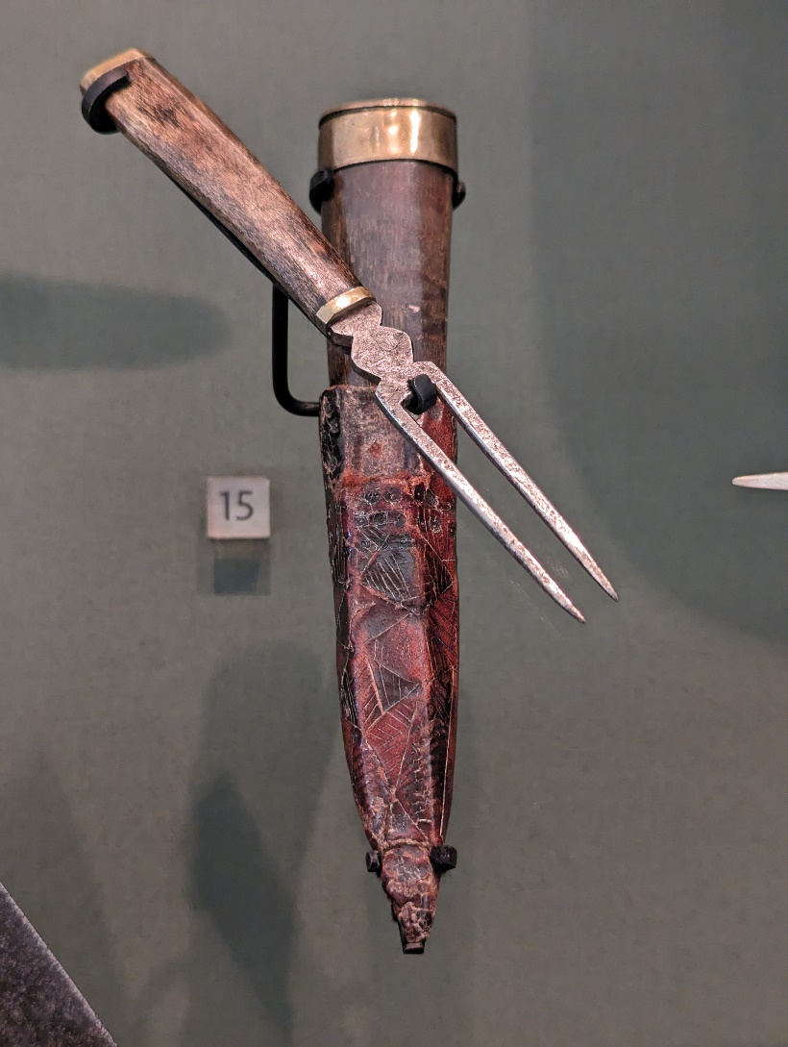
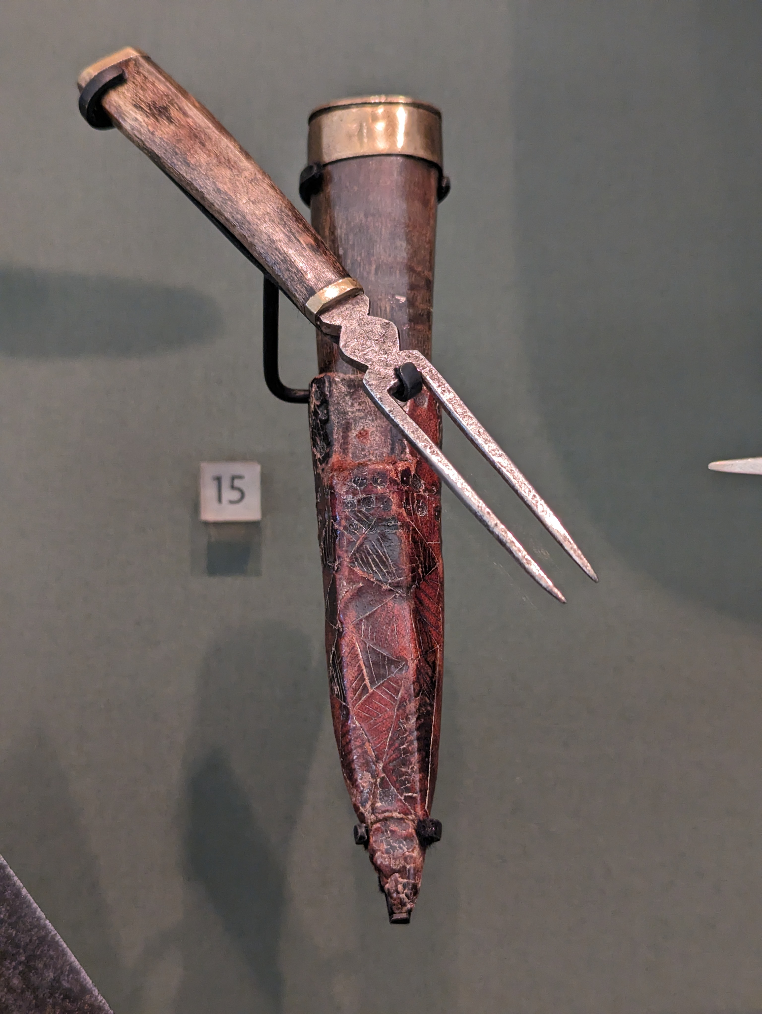
Notes:
Dirk with Sheath and fork

Slide 7
Notes:
Sampler

Slide 8
These glasses were used to convey hidden symbols and messages of support to Jacobites. What sort of symbols can you see?
Jacobite Glasses

Slide 9
Pendant Cross
This Cross was found on the Southern side of the battlefield, during the 2006 Archaeological digs.
Who do you think belonged to?
Notes:
This Cross was found near the Jacobite lines and was likely worn around the neck. During the Archaeological excavations in 2006, many Buckels and buttons were found as they are the sorts of things that could be torn off while hand to hand fighting. it may be that this is the case with this object.

Slide 10
The Brodie Sword was given to Charles Edward Stuart as part of a 21st Birthday Gift from the Duke of Perth.
The Brodie Sword
Notes:
This Sword was It was recovered from the Jacobite baggage train following the battle and taken to Brodie Castle, where it remained until 2007.
This image is of the basket hilt of the sword, on it you can see a range of symbols including clubs and swords
The Sword can now be see at the Culloden battlefield and visitor center

Slide 11
Sgian Dubh
This Sgian Dubh features a fork pouch fitted into the sheath.
Notes:
A Sgian Dubh or black knife was worn as part of everyday clothing. It is also referred to as a Dirk. It was a multifunctional tool, this one includes a fork which enabled the wearer to carry a full cutlery set while working or travelling, without adding significantly to their baggage.

Slide 12
Embroidery
Sampler
This sampler was created by a
12-year-old girl in 1746 following the battle.
Notes:
Embroidery samplers were used to show off sewing skills and literacy; this one is produced by a 12-year-old in the aftermath of Culloden. on it you can see an image of a government soldier with the name Peter Law above his head. He is pictured stabbing a Jacobite.
It shows examples of the propaganda that was circulating at the time.

